Slide 1
TRANSACTION MANAGEMENT
Course : ISYS6280 –Database Systems (GAT)
Year : 2015
Session 13&14

Slide 2
LEARNING OUTCOMES
LO 4: Evaluate database processing and security Mechanism

Slide 3
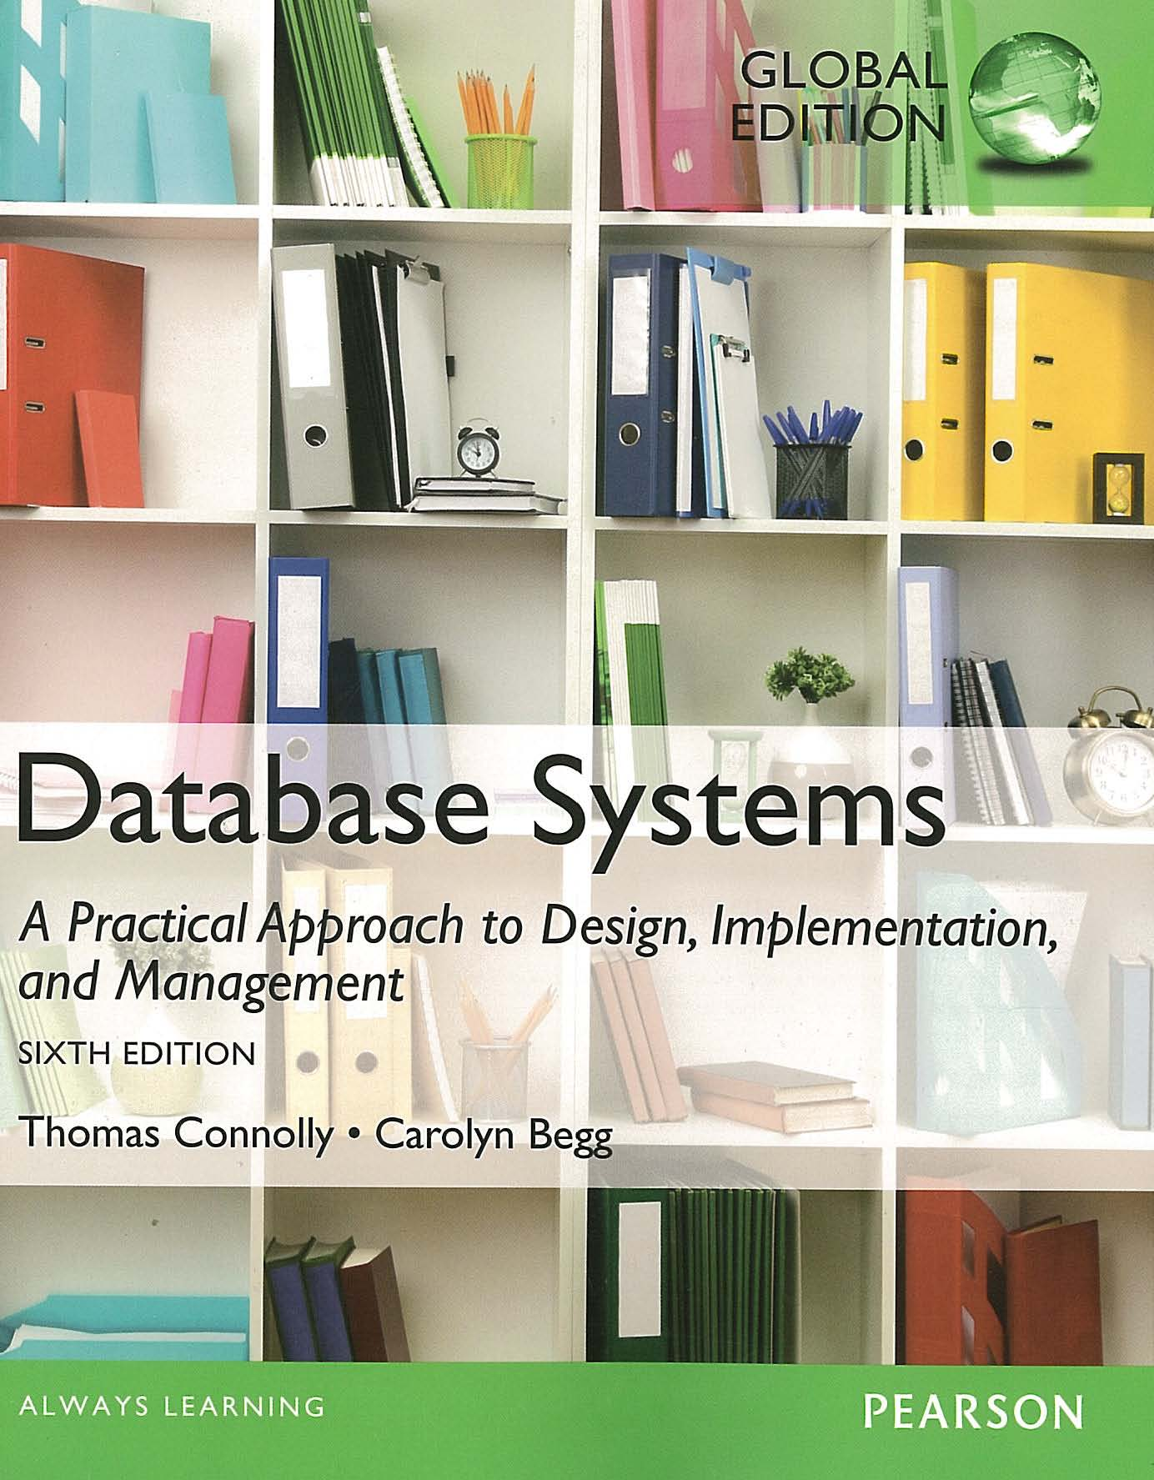
ACKNOWLEDGEMENT
These slides have been adapted from Thomas Connolly and Carolyn Begg. 2015. Database Systems: A Practical Approach To Design, Implementation, and Management. Pearson Education. USA. ISBN:978-1-292-06118-4

Slide 4
CHAPTER 22 TRANSACTION MANAGEMENT

Slide 5

LEARNING OBJECTIVES
Function and importance of transactions.
Properties of transactions.
Concurrency Control
Meaning of serializability.
How locking can ensure serializability.
Deadlock and how it can be resolved.
How timestamping can ensure serializability.
Optimistic concurrency control.
Granularity of locking.
vtraining-msuhandi.blogspot.com

Slide 6
LEARNING OBJECTIVES
Recovery Control
Some causes of database failure.
Purpose of transaction log file.
Purpose of checkpointing.
How to recover following database failure.
Alternative models for long duration transactions.
vtraining-msuhandi.blogspot.com

Slide 7
Transaction Support
Transaction
Action, or series of actions, carried out by user or application, which reads or updates contents of database.
Logical unit of work on the database.
Application program is series of transactions with non-database processing in between.
Transforms database from one consistent state to another, although consistency may be violated during transaction.

Slide 8
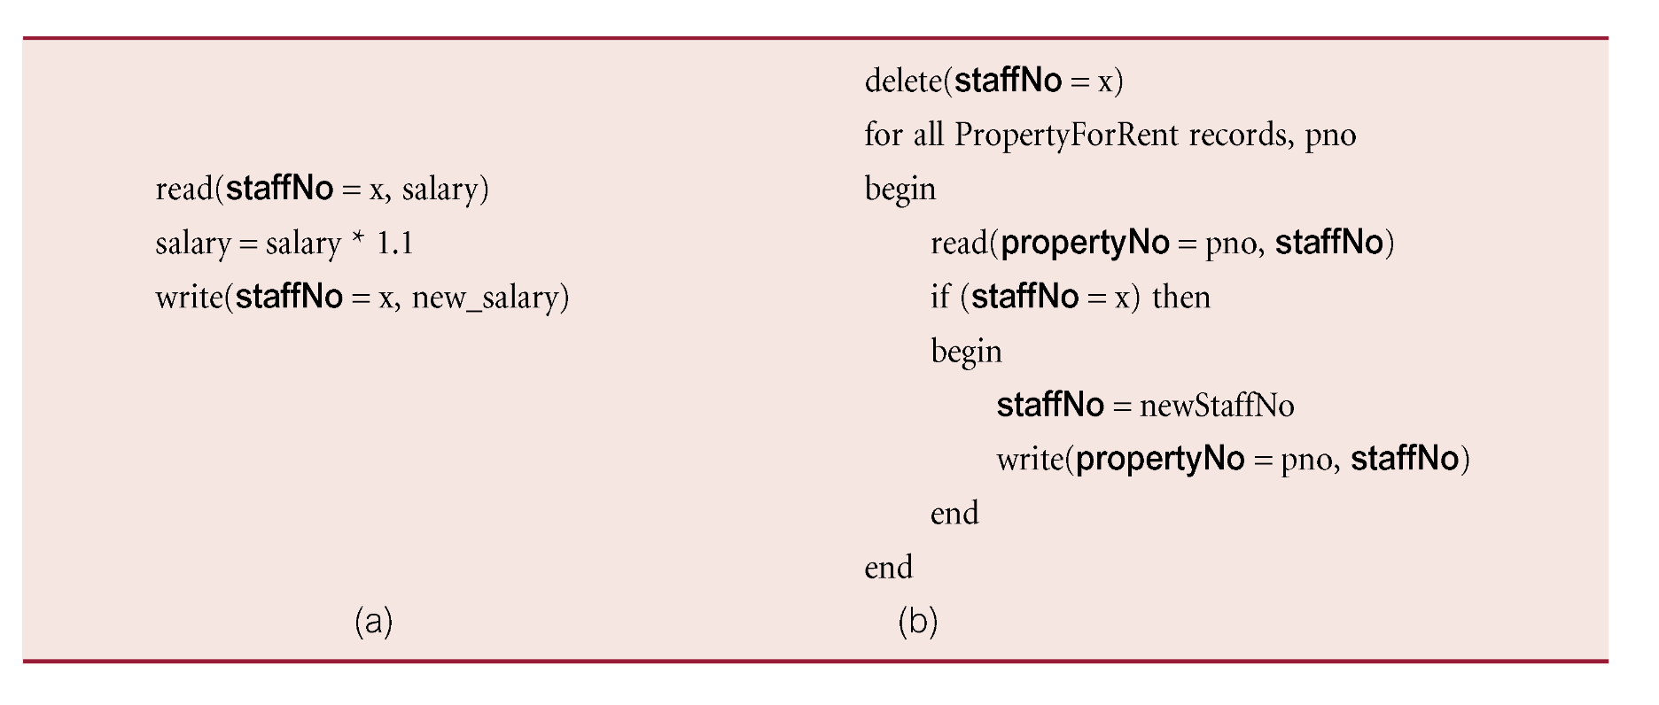
Example Transaction

Slide 9
Transaction Support
Can have one of two outcomes:
Success - transaction commits and database reaches a new consistent state.
Failure - transaction aborts, and database must be restored to consistent state before it started.
Such a transaction is rolled back or undone.
Committed transaction cannot be aborted.
Aborted transaction that is rolled back can be restarted later.

Slide 10
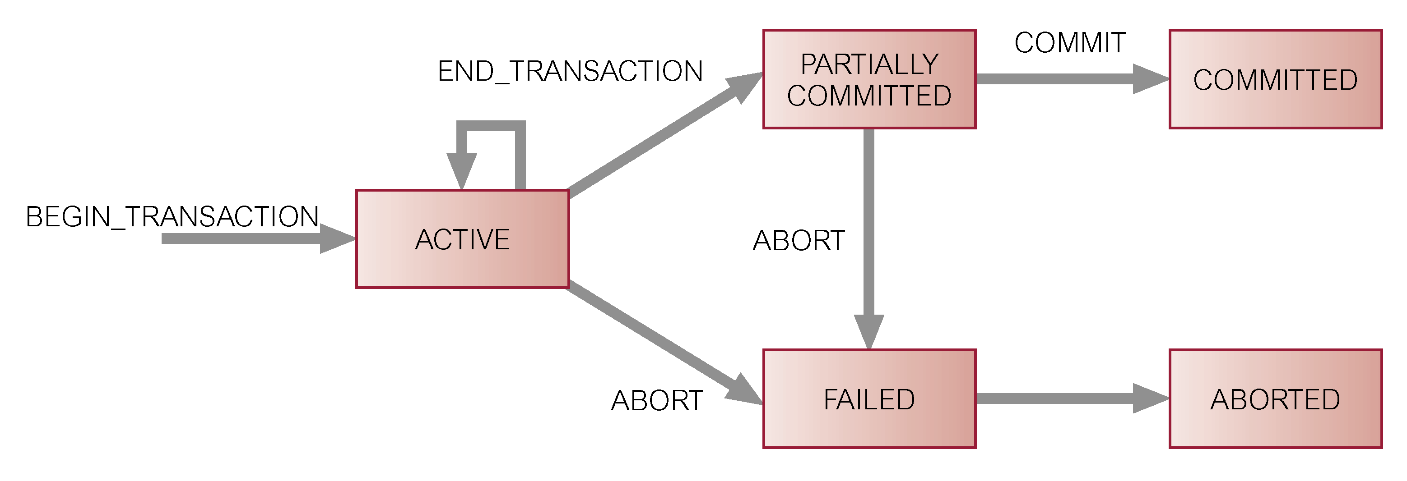
State Transition Diagram for Transaction

Slide 11
Properties of Transactions
Four basic (ACID) properties that define a transaction are:
Atomicity ‘All or nothing’ property.
Consistency Must transform database from one consistent state to another.
Isolation Partial effects of incomplete transactions should not be visible to other transactions.
Durability Effects of a committed transaction are permanent and must not be lost because of later failure.

Slide 12
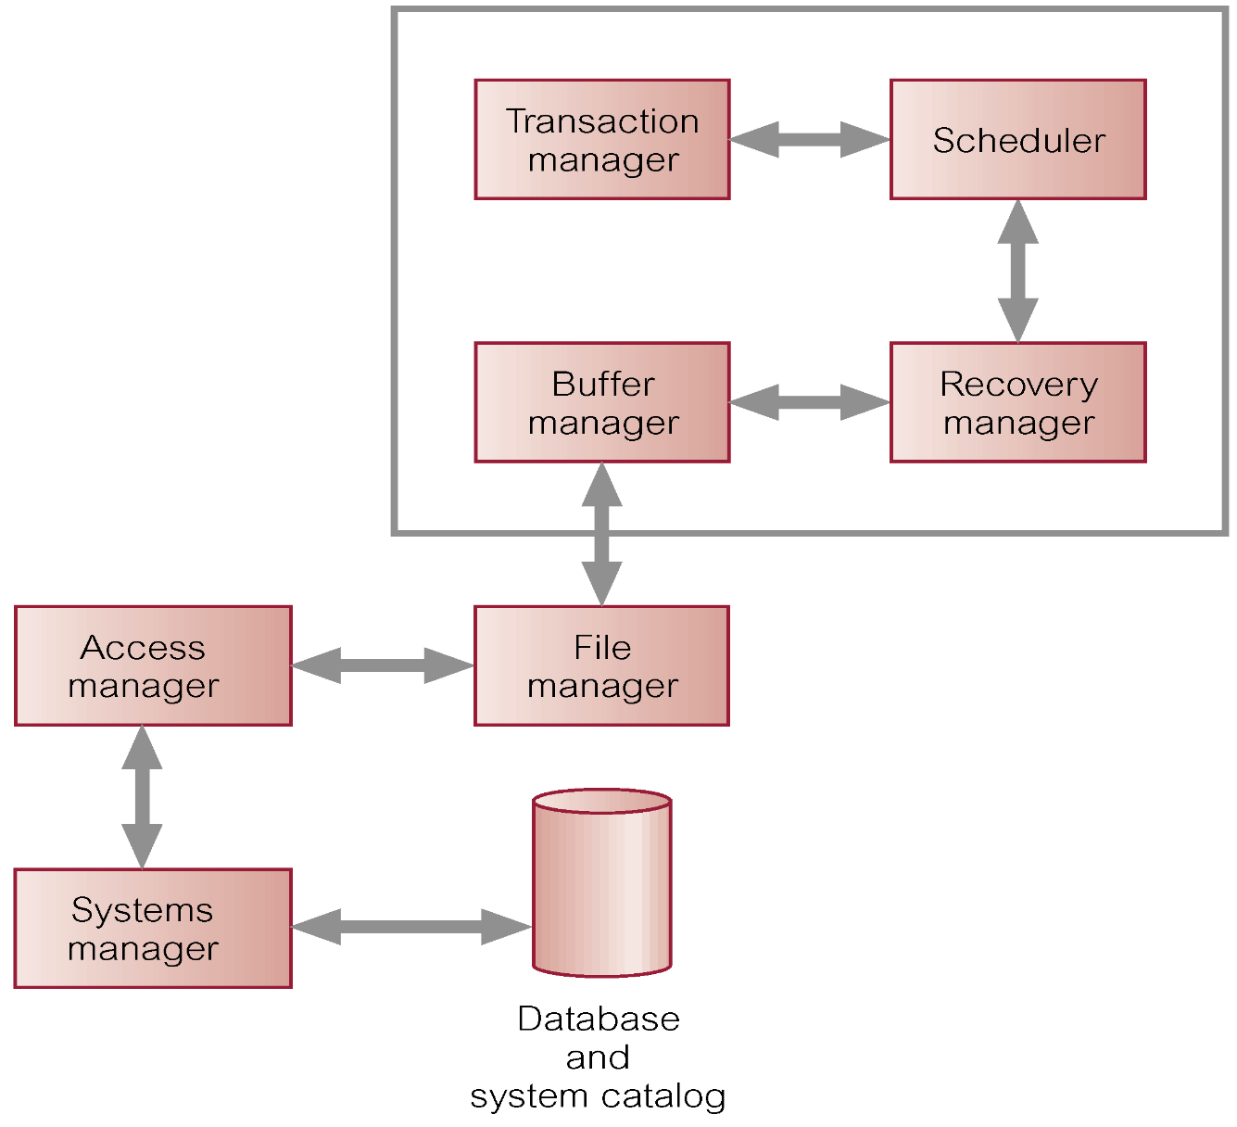
DBMS Transaction Subsystem

Slide 13
Concurrency Control
Process of managing simultaneous operations on the database without having them interfere with one another.
Prevents interference when two or more users are accessing database simultaneously and at least one is updating data.
Although two transactions may be correct in themselves, interleaving of operations may produce an incorrect result.

Slide 14

Need for Concurrency Control
Three examples of potential problems caused by concurrency:
Lost update problem.
Uncommitted dependency problem.
Inconsistent analysis problem.
www.conceptdraw.com

Slide 15
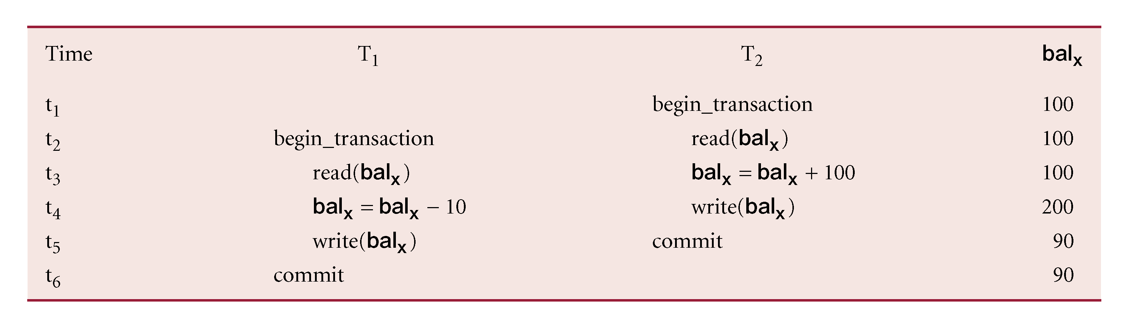
Lost Update Problem
Successfully completed update is overridden by another user.
T₁ withdrawing £10 from an account with bal_{x}, initially £100.
T₂ depositing £100 into same account.
Serially, final balance would be £190.
Loss of T₂’s update avoided by preventing T₁ from reading bal_{x} until after update.

Slide 16
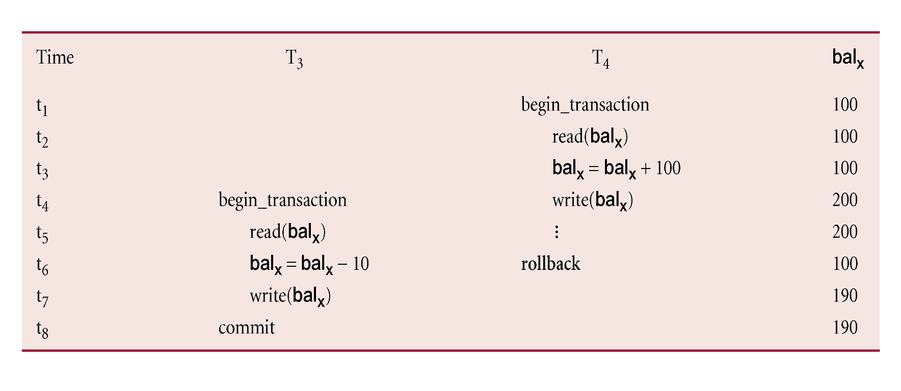
Uncommitted Dependency Problem
Occurs when one transaction can see intermediate results of another transaction before it has committed.
T₄ updates bal_{x} to £200 but it aborts, so bal_{x} should be back at original value of £100.
T₃ has read new value of bal_{x} (£200) and uses value as basis of £10 reduction, giving a new balance of £190, instead of £90.
Problem avoided by preventing T₃ from reading bal_{x} until after T₄ commits or aborts.

Slide 17

Inconsistent Analysis Problem
Occurs when transaction reads several values but second transaction updates some of them during execution of first.
Sometimes referred to as dirty read or unrepeatable read.
T₆ is totaling balances of account x (£100), account y (£50), and account z (£25).
Meantime, T₅ has transferred £10 from bal_{x} to bal_{z}, so T₆ now has wrong result (£10 too high).
seventhsoulmountain.blogspot.com

Slide 18
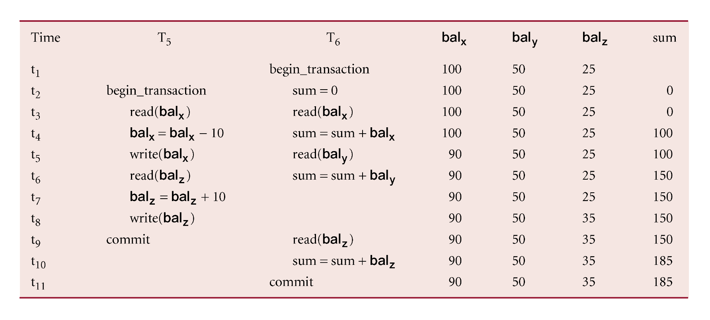
Inconsistent Analysis Problem
Problem avoided by preventing T₆ from reading bal_{x} and bal_{z} until after T₅ completed updates.

Slide 19
Serializability
Objective of a concurrency control protocol is to schedule transactions in such a way as to avoid any interference.
Could run transactions serially, but this limits degree of concurrency or parallelism in system.
Serializability identifies those executions of transactions guaranteed to ensure consistency.

Slide 20
Serializability
Schedule
Sequence of reads/writes by set of concurrent transactions.
Serial Schedule
Schedule where operations of each transaction are executed consecutively without any interleaved operations from other transactions.
No guarantee that results of all serial executions of a given set of transactions will be identical.

Slide 21
Nonserial Schedule
Schedule where operations from set of concurrent transactions are interleaved.
Objective of serializability is to find nonserial schedules that allow transactions to execute concurrently without interfering with one another.
In other words, want to find nonserial schedules that are equivalent to some serial schedule. Such a schedule is called serializable.

Slide 22
Serializability
In serializability, ordering of read/writes is important:
(a) If two transactions only read a data item, they do not conflict and order is not important.
(b) If two transactions either read or write separate data items, they do not conflict and order is not important.
(c) If one transaction writes a data item and another reads or writes same data item, order of execution is important.

Slide 23
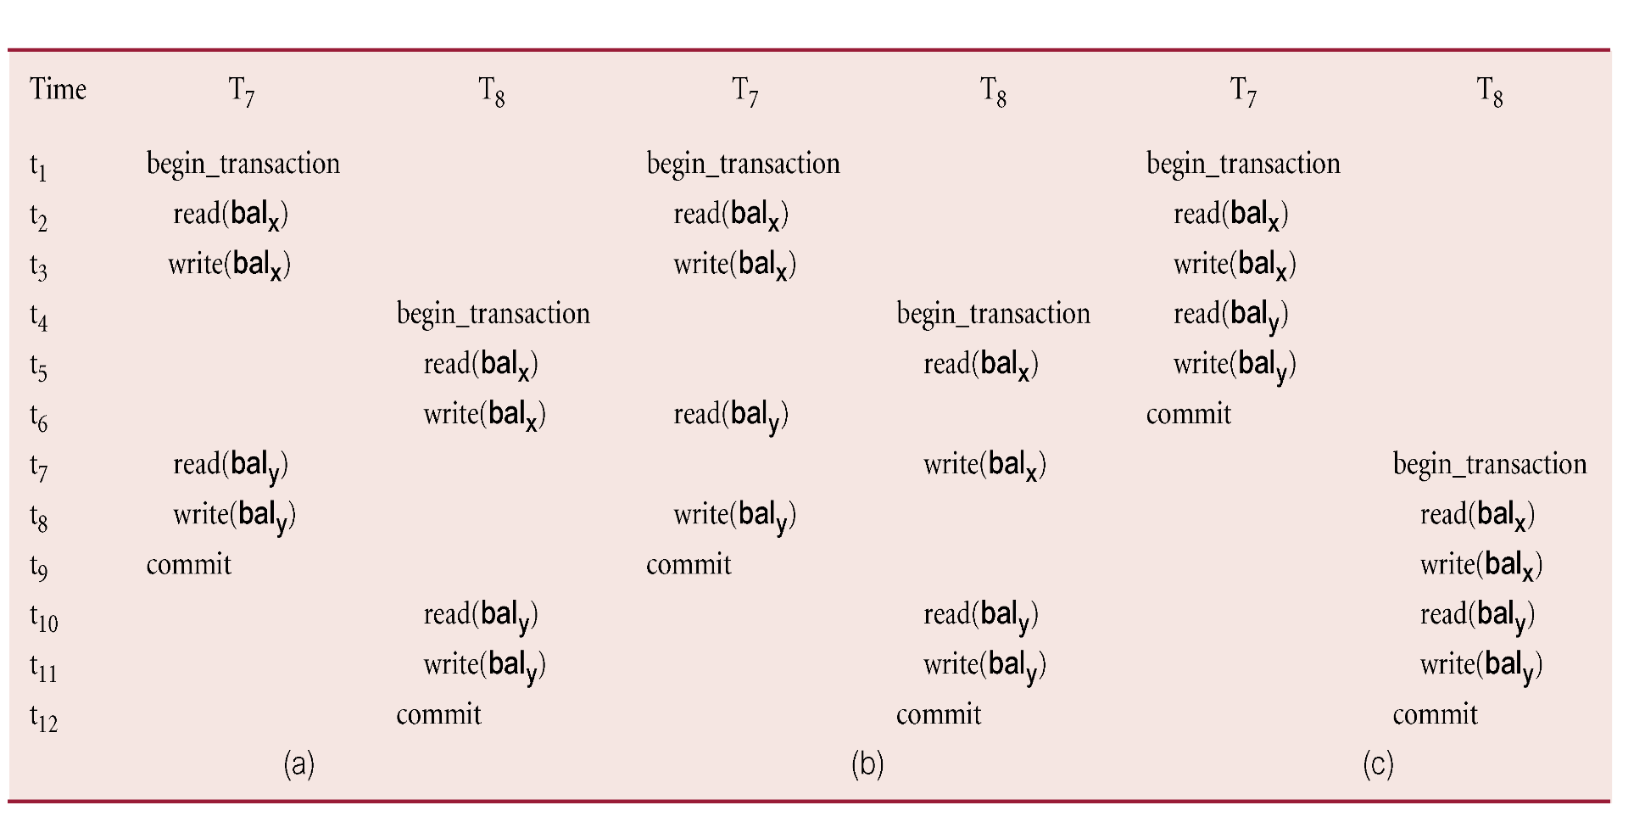
Example of Conflict Serializability

Slide 24
Serializability
Conflict serializable schedule orders any conflicting operations in same way as some serial execution.
Under constrained write rule (transaction updates data item based on its old value, which is first read), use precedence graph to test for serializability.

Slide 25
Precedence Graph
Create:
node for each transaction;
a directed edge T_{i} → T_{j}, if T_{j} reads the value of an item written by T_{I};
a directed edge T_{i} → T_{j}, if T_{j} writes a value into an item after it has been read by T_{i}.
If precedence graph contains cycle schedule is not conflict serializable.

Slide 26
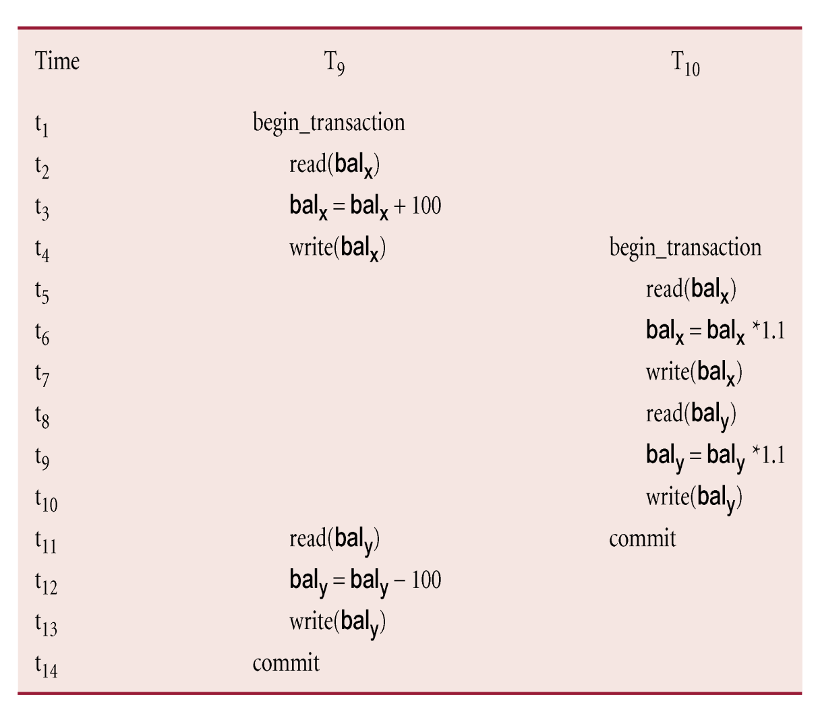
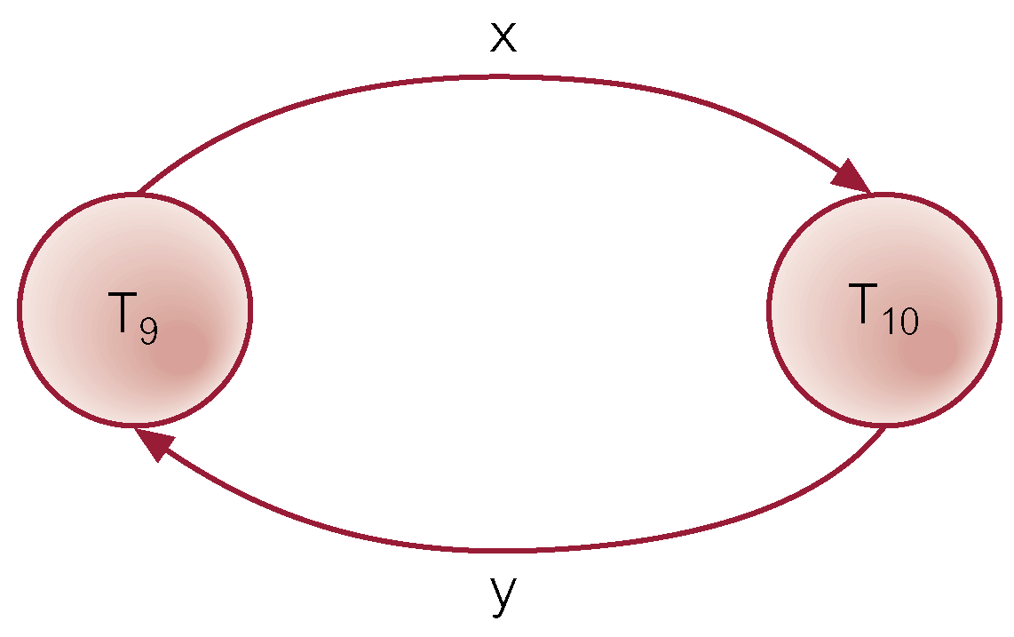
Example - Non-conflict serializable schedule
T₉ is transferring £100 from one account with balance bal_{x} to another account with balance bal_{y}.
T₁₀ is increasing balance of these two accounts by 10%.
Precedence graph has a cycle and so is not serializable.

Slide 27
View Serializability
Offers less stringent definition of schedule equivalence than conflict serializability.
Two schedules S₁ and S₂ are view equivalent if:
For each data item x, if T_{i} reads initial value of x in S₁, T_{i} must also read initial value of x in S₂.
For each read on x by T_{i} in S₁, if value read by T_{i} is written by T_{j}, T_{i} must also read value of x produced by T_{j} in S₂.
For each data item x, if last write on x performed by T_{i} in S₁, same transaction must perform final write on x in S₂.

Slide 28
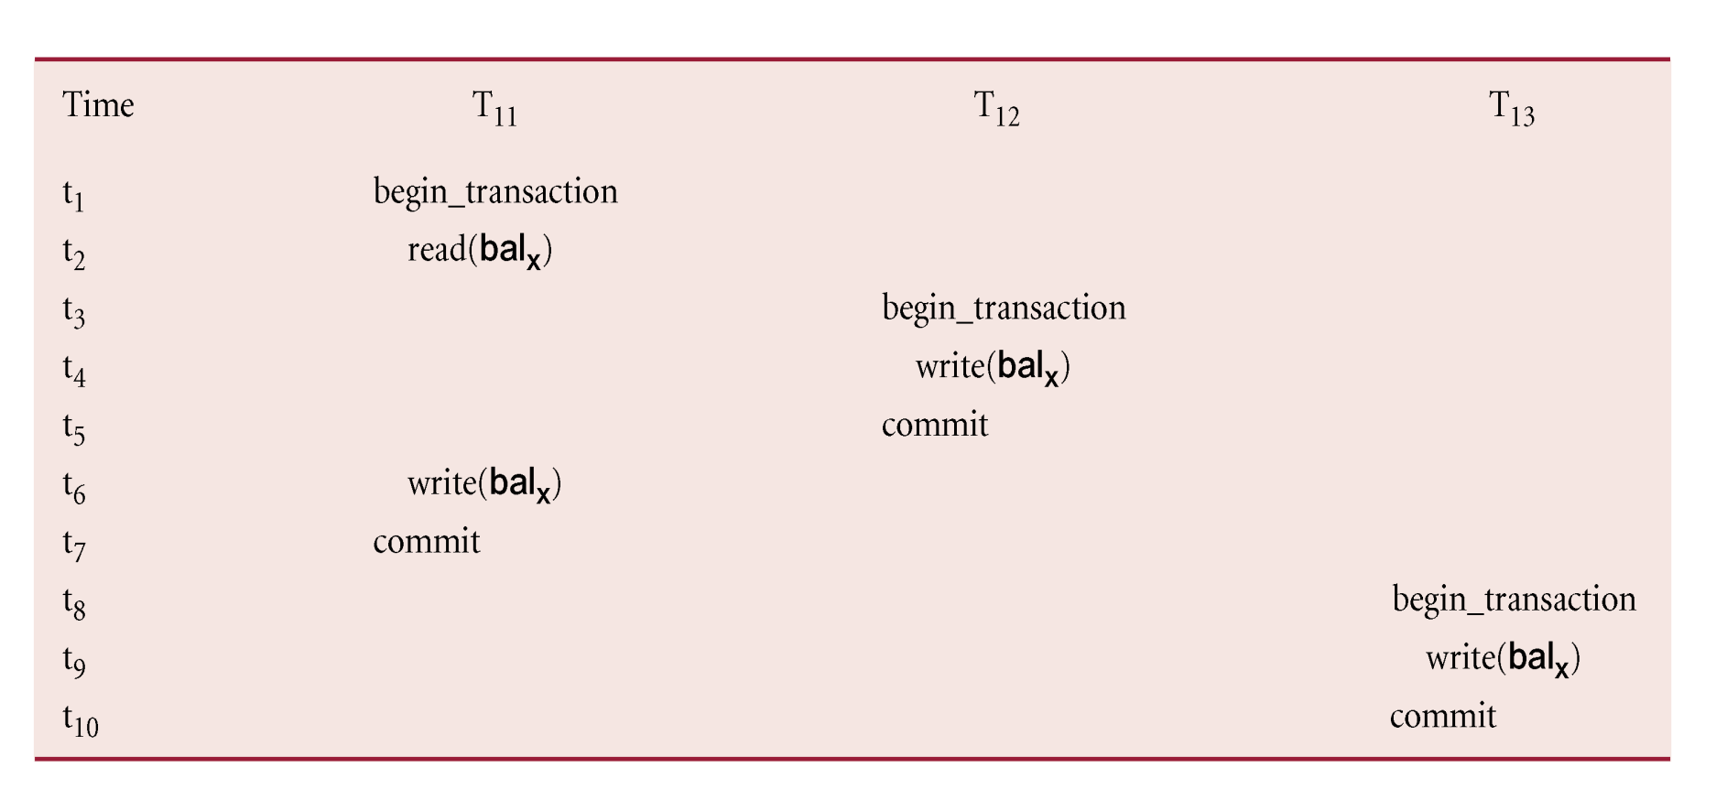
View Serializability
Schedule is view serializable if it is view equivalent to a serial schedule.
Every conflict serializable schedule is view serializable, although converse is not true.
It can be shown that any view serializable schedule that is not conflict serializable contains one or more blind writes.
In general, testing whether schedule is serializable is NP-complete.

Slide 29
Recoverability
Serializability identifies schedules that maintain database consistency, assuming no transaction fails.
Could also examine recoverability of transactions within schedule.
If transaction fails, atomicity requires effects of transaction to be undone.
Durability states that once transaction commits, its changes cannot be undone (without running another, compensating, transaction).
A schedule where, for each pair of transactions T_{i} and T_{j}, if T_{j} reads a data item previously written by T_{i}, then the commit operation of T_{i} precedes the commit operation of T_{j.}
Recoverable Schedule

Slide 30
Concurrency Control Techniques
Two basic concurrency control techniques:
Both are conservative approaches: delay transactions in case they conflict with other transactions.
Optimistic methods assume conflict is rare and only check for conflicts at commit.
Locking
Time stamping

Slide 31
Locking
Transaction uses locks to deny access to other transactions and so prevent incorrect updates.
Most widely used approach to ensure serializability.
Generally, a transaction must claim a shared (read) or exclusive (write) lock on a data item before read or write.
Lock prevents another transaction from modifying item or even reading it, in the case of a write lock.

Slide 32

Locking - Basic Rules
If transaction has shared lock on item, can read but not update item.
If transaction has exclusive lock on item, can both read and update item.
Reads cannot conflict, so more than one transaction can hold shared locks simultaneously on same item.
Exclusive lock gives transaction exclusive access to that item.
Some systems allow transaction to upgrade read lock to an exclusive lock, or downgrade exclusive lock to a shared lock.
synergyexpert.com

Slide 33
Example - Incorrect Locking Schedule
For two transactions above, a valid schedule using these rules is:
S = {write_lock(T₉, bal_{x}), read(T₉, bal_{x}), write(T₉, bal_{x}), unlock(T₉, bal_{x}), write_lock(T₁₀, bal_{x}), read(T₁₀, bal_{x}), write(T₁₀, bal_{x}), unlock(T₁₀, bal_{x}), write_lock(T₁₀, bal_{y}), read(T₁₀, bal_{y}), write(T₁₀, bal_{y}), unlock(T₁₀, bal_{y}), commit(T₁₀), write_lock(T₉, bal_{y}), read(T₉, bal_{y}), write(T₉, bal_{y}), unlock(T₉, bal_{y}), commit(T₉) }

Slide 34
Example - Incorrect Locking Schedule
If at start, bal_{x} = 100, bal_{y} = 400, result should be:
bal_{x} = 220, bal_{y} = 330, if T₉ executes before T₁₀, or
bal_{x} = 210, bal_{y} = 340, if T₁₀ executes before T₉.
However, result gives bal_{x} = 220 & bal_{y} = 340.
S is not a serializable schedule.
Problem is that transactions release locks too soon, resulting in loss of total isolation and atomicity.
To guarantee serializability, need an additional protocol concerning the positioning of lock and unlock operations in every transaction.

Slide 35
Two-Phase Locking (2PL)
Transaction follows 2PL protocol if all locking operations precede first unlock operation in the transaction.
Two phases for transaction:
Growing phase - acquires all locks but cannot release any locks.
Shrinking phase - releases locks but cannot acquire any new locks.

Slide 36
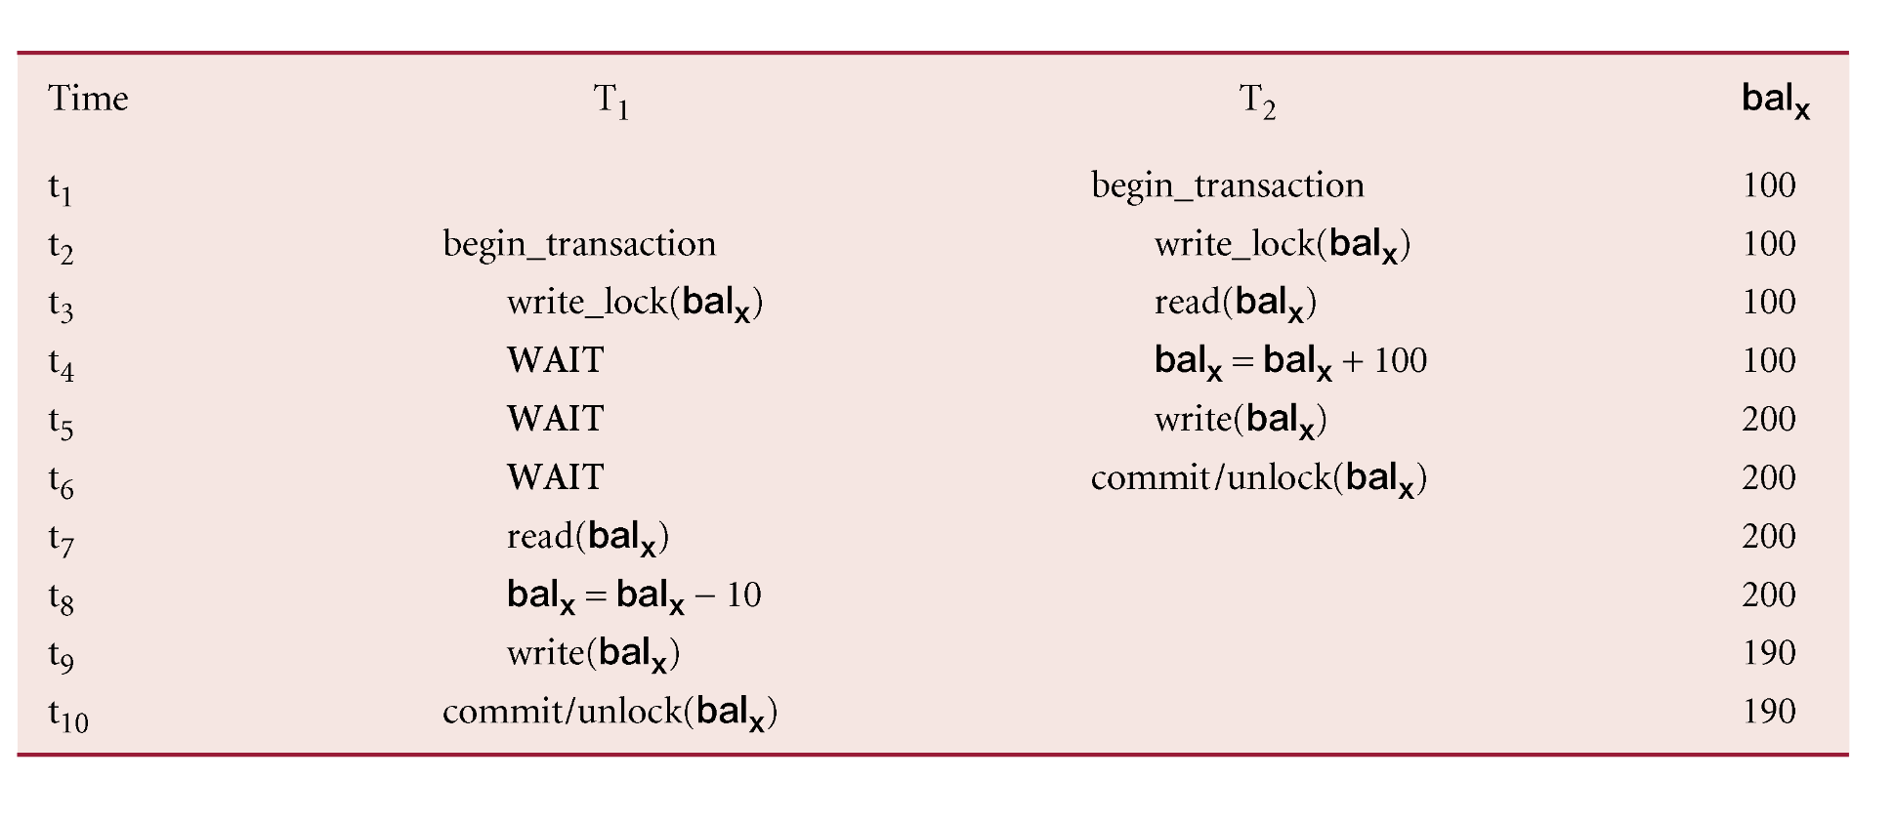
Preventing Lost Update Problem using 2PL

Slide 37
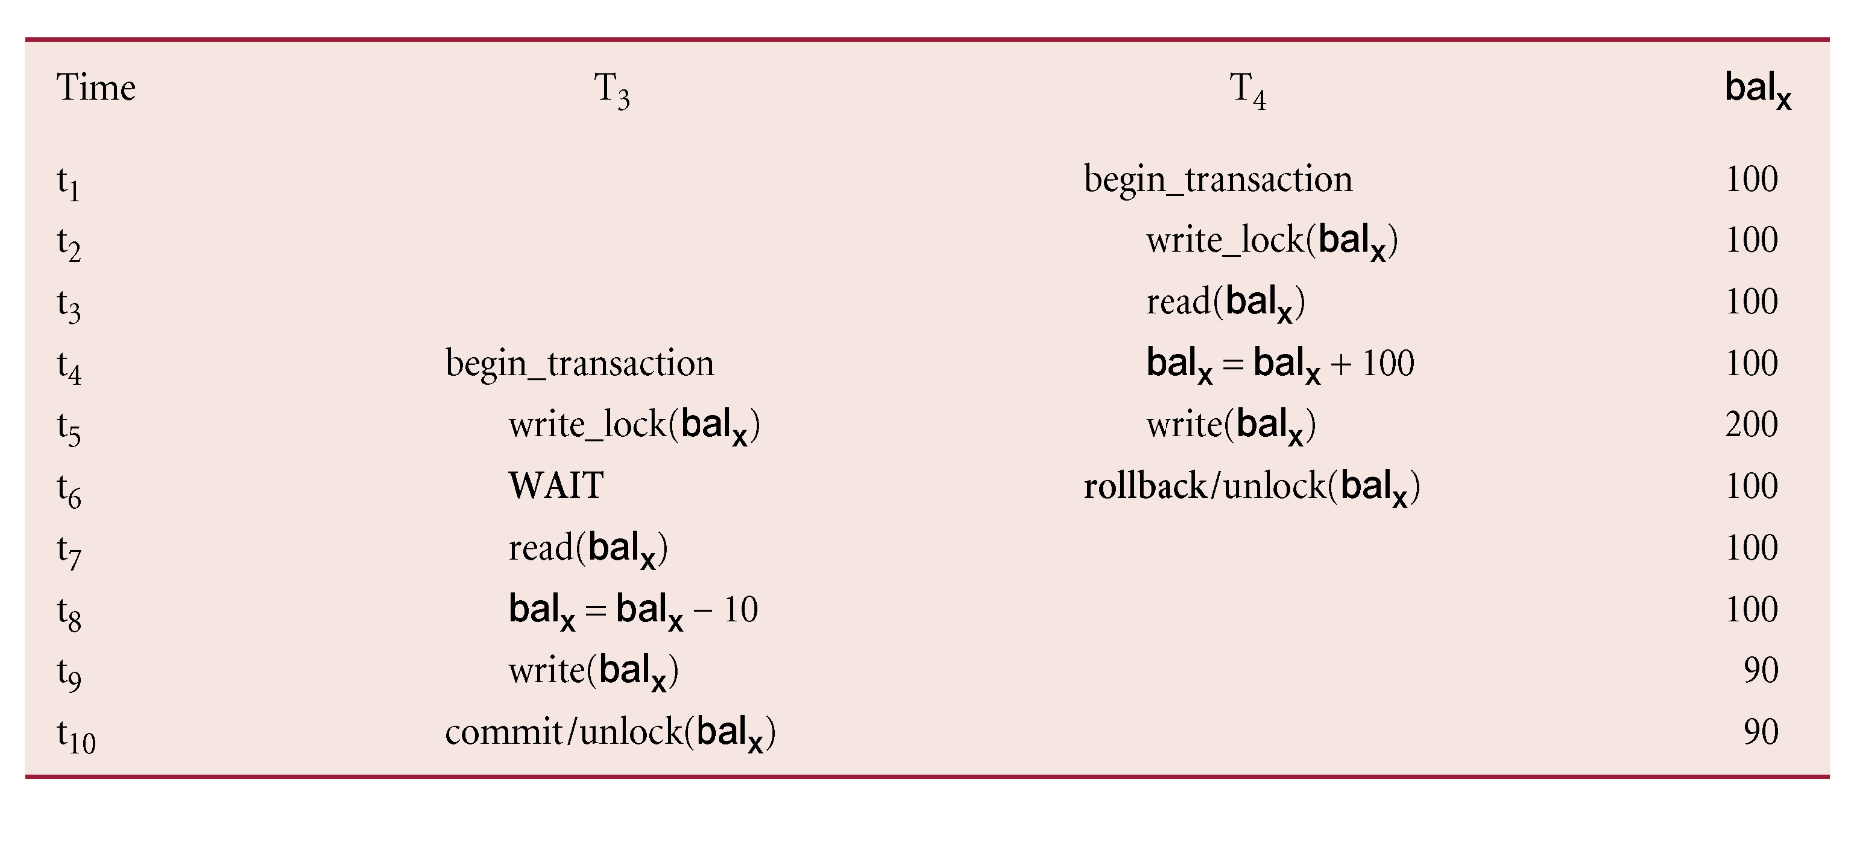
Preventing Uncommitted Dependency Problem using 2PL

Slide 38
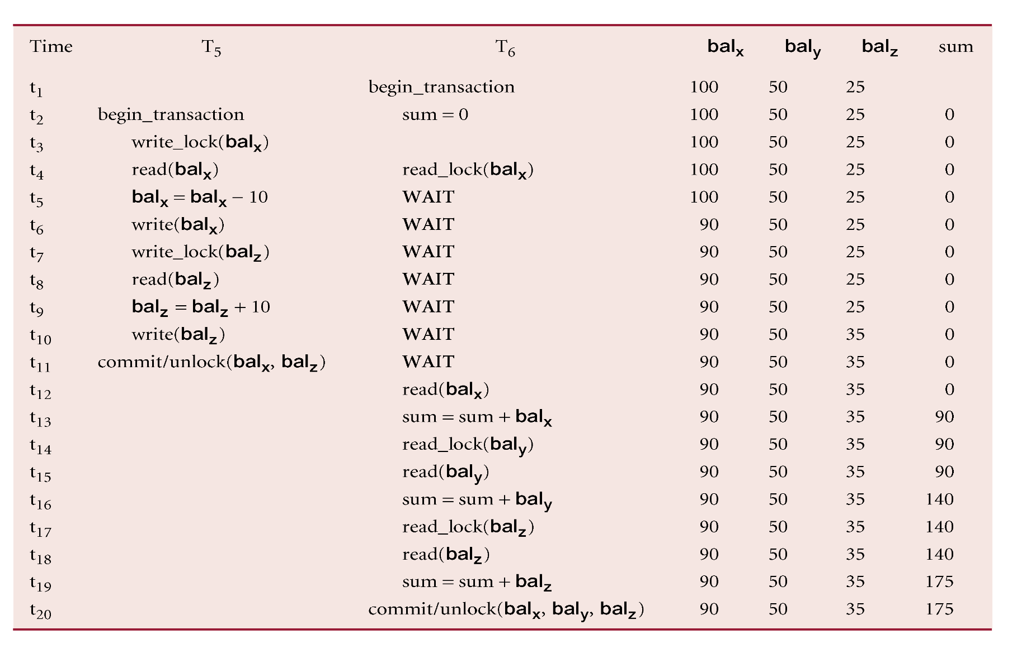
Preventing Inconsistent Analysis Problem using 2PL

Slide 39
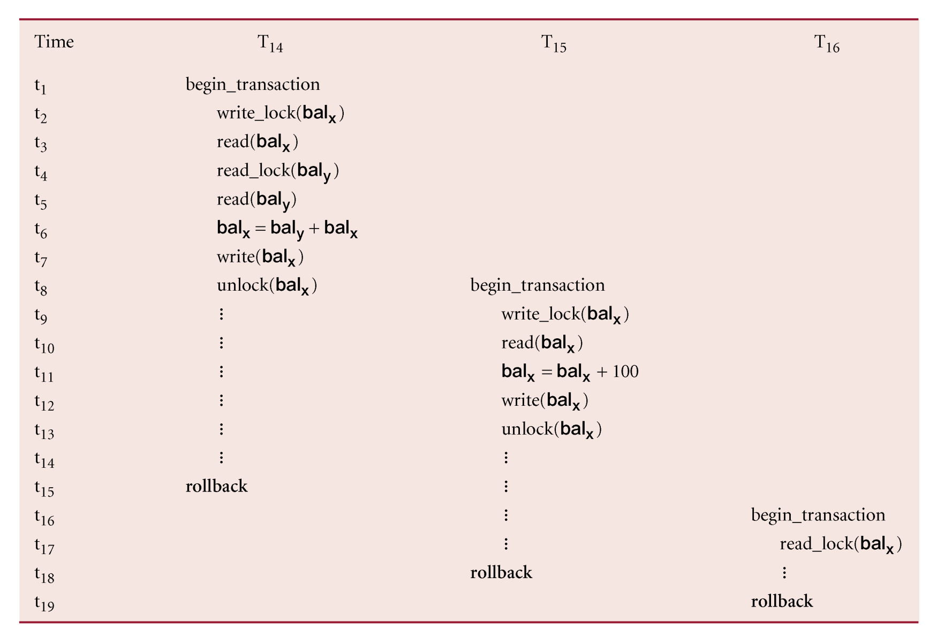
Cascading Rollback
If every transaction in a schedule follows 2PL, schedule is serializable.
However, problems can occur with interpretation of when locks can be released.

Slide 40
Cascading Rollback
Transactions conform to 2PL.
T₁₄ aborts.
Since T₁₅ is dependent on T₁₄, T₁₅ must also be rolled back. Since T₁₆ is dependent on T₁₅, it too must be rolled back.
This is called cascading rollback.
To prevent this with 2PL, leave release of all locks until end of transaction.

Slide 41
Concurrency Control with Index Structures
Could treat each page of index as a data item and apply 2PL.
However, as indexes will be frequently accessed, particularly higher levels, this may lead to high lock contention.
Two points about index traversal:
Search path starts from root and moves down to leaf nodes but search never moves back up tree. Thus, once a lower-level node has been accessed, higher-level nodes in that path will not be used again.
When new index value (key and pointer) is being inserted into a leaf node, then if node is not full, insertion will not cause changes to higher-level nodes.

Slide 42
Concurrency Control with Index Structures
Only have to exclusively lock leaf node in such a case, and only exclusively lock higher-level nodes if node is full and has to be split.
Thus, can derive following locking strategy:
For searches, obtain shared locks on nodes starting at root and proceeding downwards along required path. Release lock on node once lock has been obtained on the child node.
For insertions, conservative approach would be to obtain exclusive locks on all nodes as we descend tree to the leaf node to be modified.
For more optimistic approach, obtain shared locks on all nodes as we descend to leaf node to be modified, where obtain exclusive lock. If leaf node has to split, upgrade shared lock on parent to exclusive lock. If this node also has to split, continue to upgrade locks at next higher level.

Slide 43
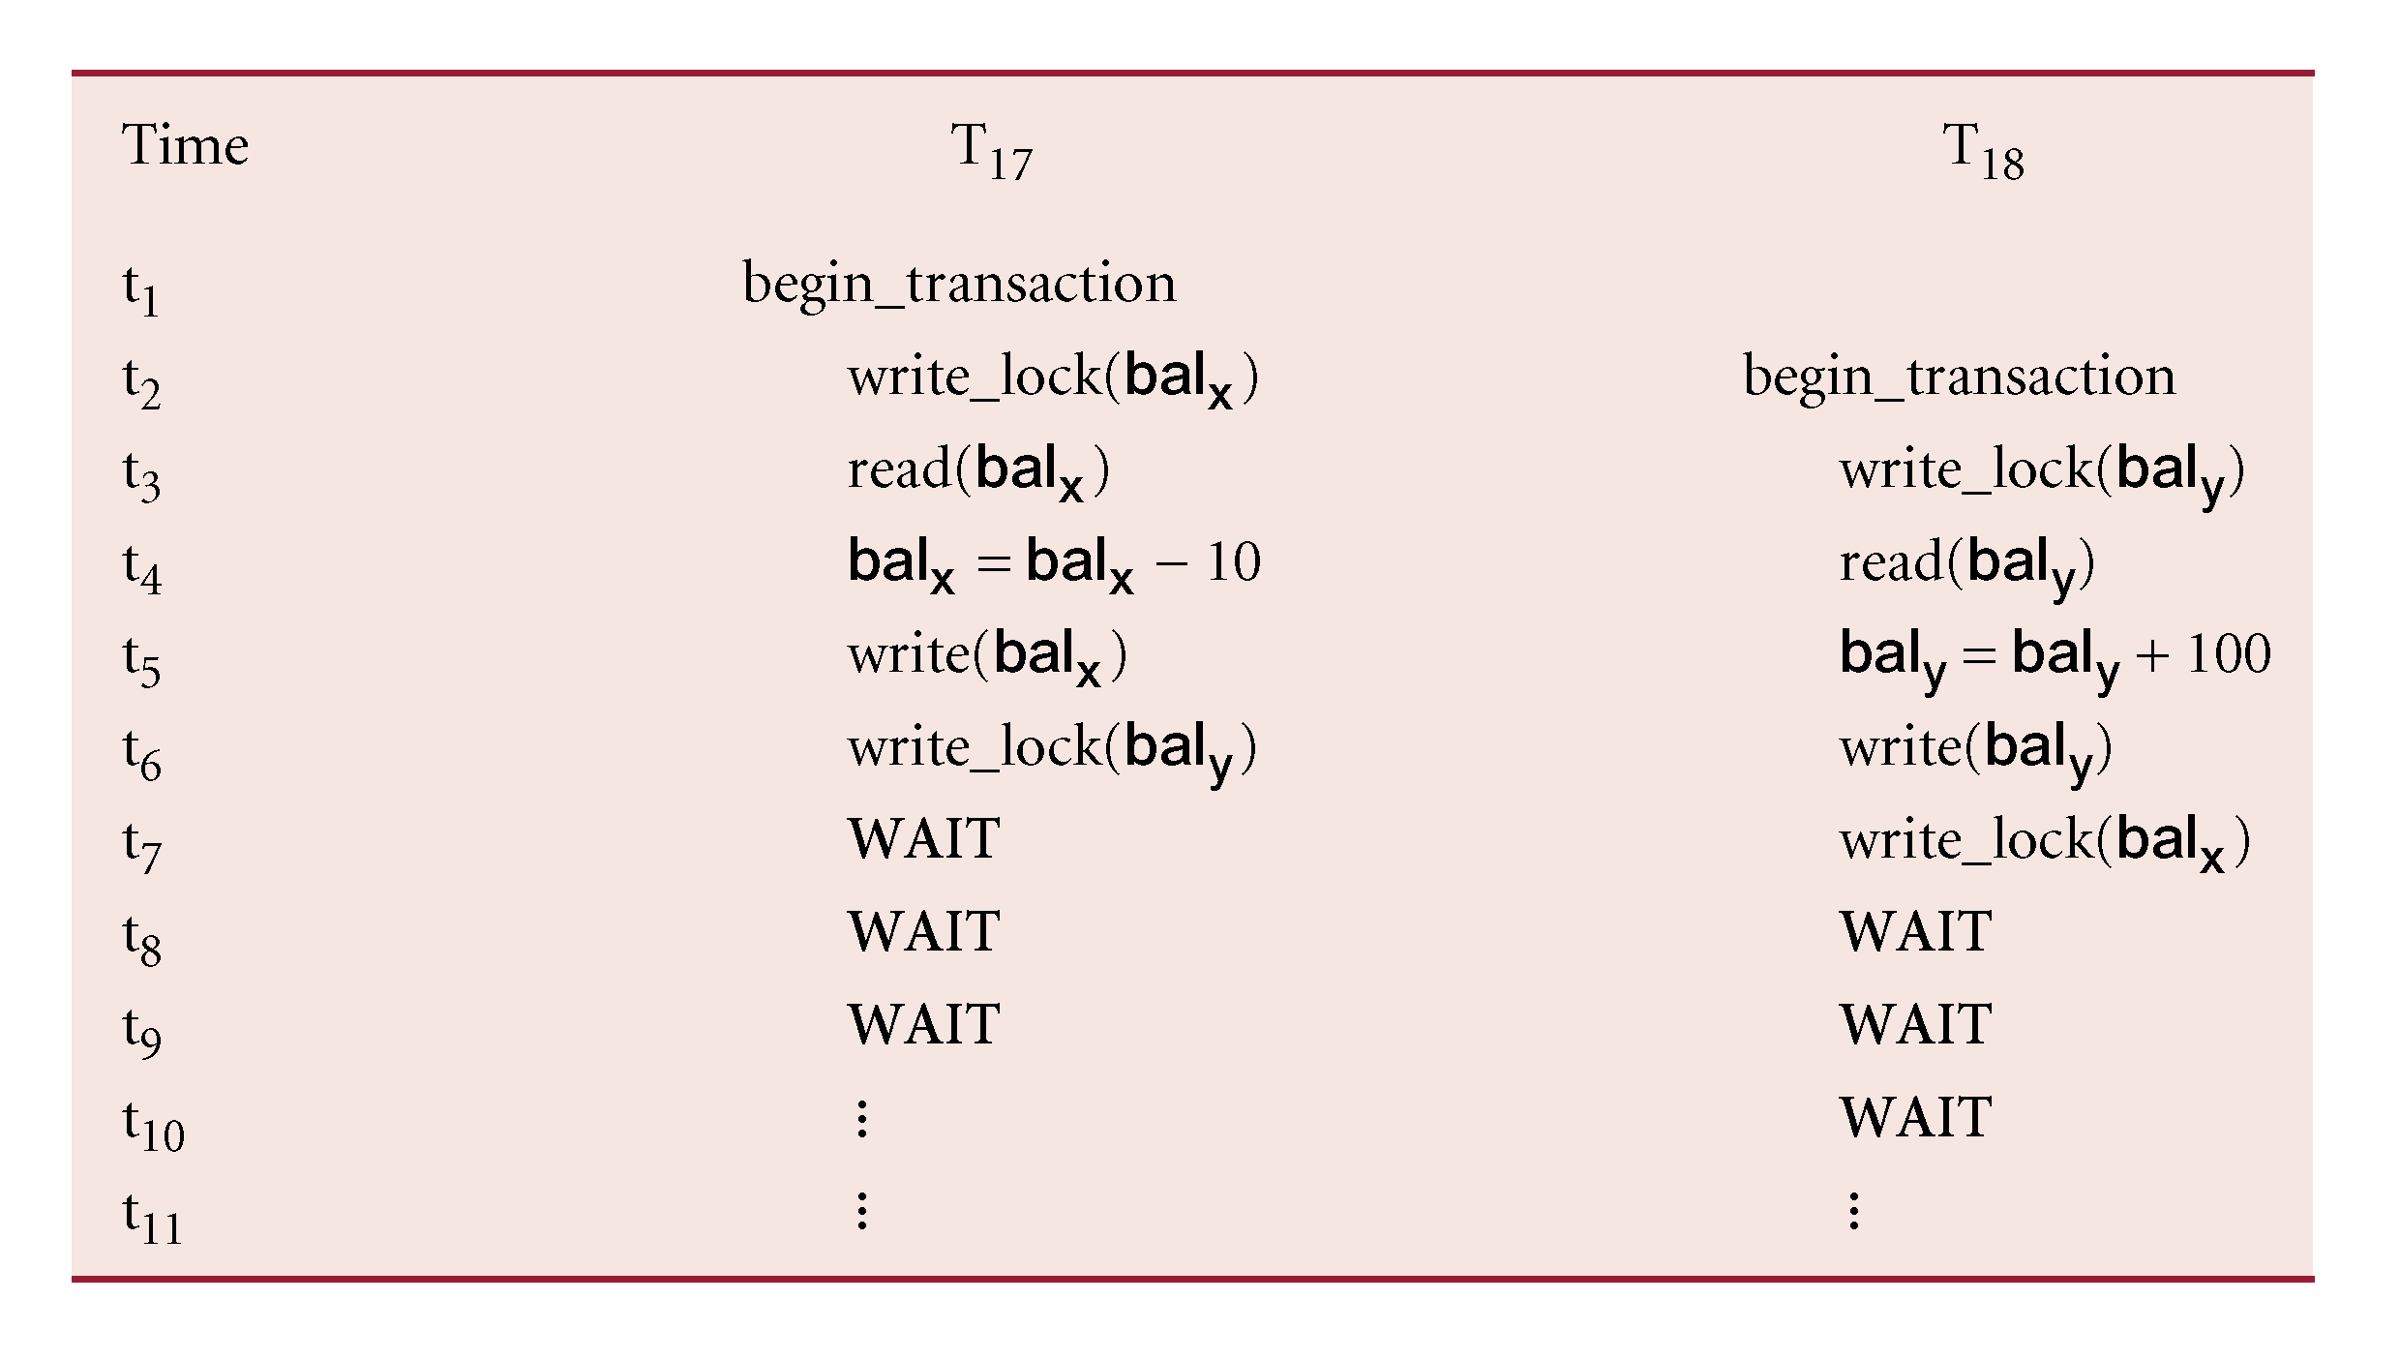
Deadlock
An impasse that may result when two (or more) transactions are each waiting for locks held by the other to be released.

Slide 44
Deadlock
Only one way to break deadlock: abort one or more of the transactions.
Deadlock should be transparent to user, so DBMS should restart transaction(s).
However, in practice DBMS cannot restart aborted transaction since it is unaware of transaction logic even if it was aware of the transaction history (unless there is no user input in the transaction or the input is not a function of the database state).
Three general techniques for handling deadlock:
Timeouts.
Deadlock prevention.
Deadlock detection and recovery.

Slide 45

Timeouts
Transaction that requests lock will only wait for a system-defined period of time.
If lock has not been granted within this period, lock request times out.
In this case, DBMS assumes transaction may be deadlocked, even though it may not be, and it aborts and automatically restarts the transaction.
www.basketballhow.com

Slide 46
Deadlock Prevention
DBMS looks ahead to see if transaction would cause deadlock and never allows deadlock to occur.
Could order transactions using transaction timestamps:
Wait-Die - only an older transaction can wait for younger one, otherwise transaction is aborted (dies) and restarted with same timestamp.
Wound-Wait - only a younger transaction can wait for an older one. If older transaction requests lock held by younger one, younger one is aborted (wounded).

Slide 47
Deadlock Detection and Recovery
DBMS allows deadlock to occur but recognizes it and breaks it.
Usually handled by construction of wait-for graph (WFG) showing transaction dependencies:
Create a node for each transaction.
Create edge T_{i} -> T_{j}, if T_{i} waiting to lock item locked by T_{j}.
Deadlock exists if and only if WFG contains cycle.
WFG is created at regular intervals.

Slide 48
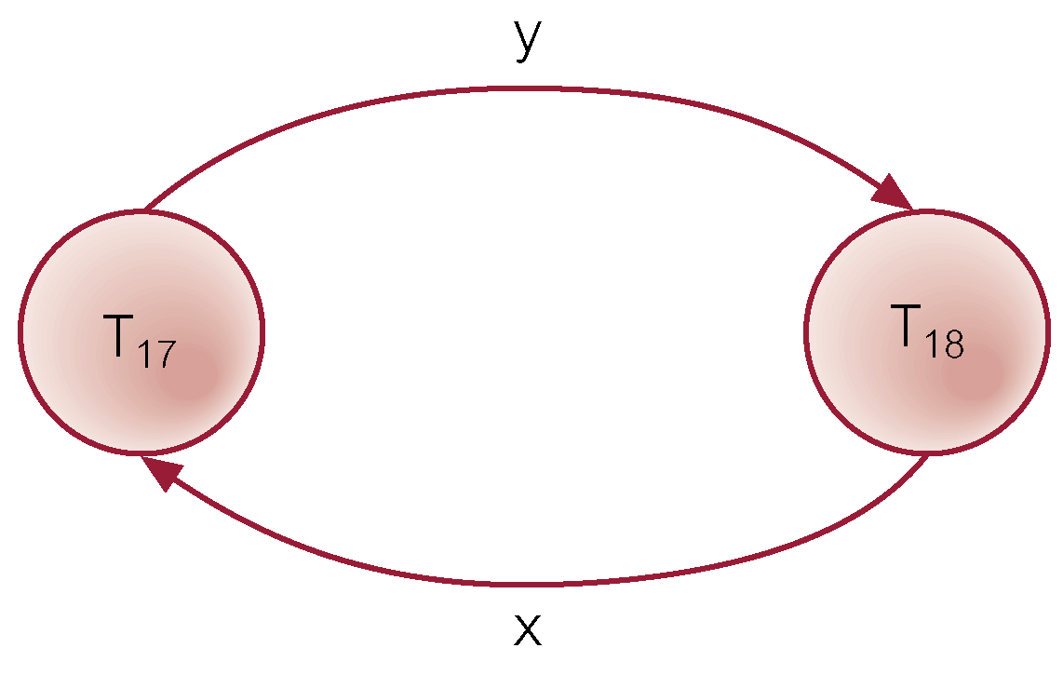
Example - Wait-For-Graph (WFG)

Slide 49

Recovery from Deadlock Detection
Several issues:
choice of deadlock victim;
how far to roll a transaction back;
avoiding starvation.
www.fireinsurancerecovery.com

Slide 50

Timestamping
Transactions ordered globally so that older transactions, transactions with smaller timestamps, get priority in the event of conflict.
Conflict is resolved by rolling back and restarting transaction.
No locks so no deadlock.
Can be generated by using system clock at time transaction started, or by incrementing a logical counter every time a new transaction starts.
A unique identifier created by DBMS that indicates relative starting time of a transaction
www.syntap.com

Slide 51
Timestamping
Read/write proceeds only if last update on that data item was carried out by an older transaction.
Otherwise, transaction requesting read/write is restarted and given a new timestamp.
Also timestamps for data items:
read-timestamp - timestamp of last transaction to read item;
write-timestamp - timestamp of last transaction to write item.

Slide 52
Timestamping - Read(x)
Consider a transaction T with timestamp ts(T):
ts(T) < write_timestamp(x)
x already updated by younger (later) transaction.
Transaction must be aborted and restarted with a new timestamp.
ts(T) < read_timestamp(x)
x already read by younger transaction.
Roll back transaction and restart it using a later timestamp.

Slide 53
Timestamping - Write(x)
ts(T) < write_timestamp(x)
x already written by younger transaction.
Write can safely be ignored - ignore obsolete write rule.
Otherwise, operation is accepted and executed.

Slide 54
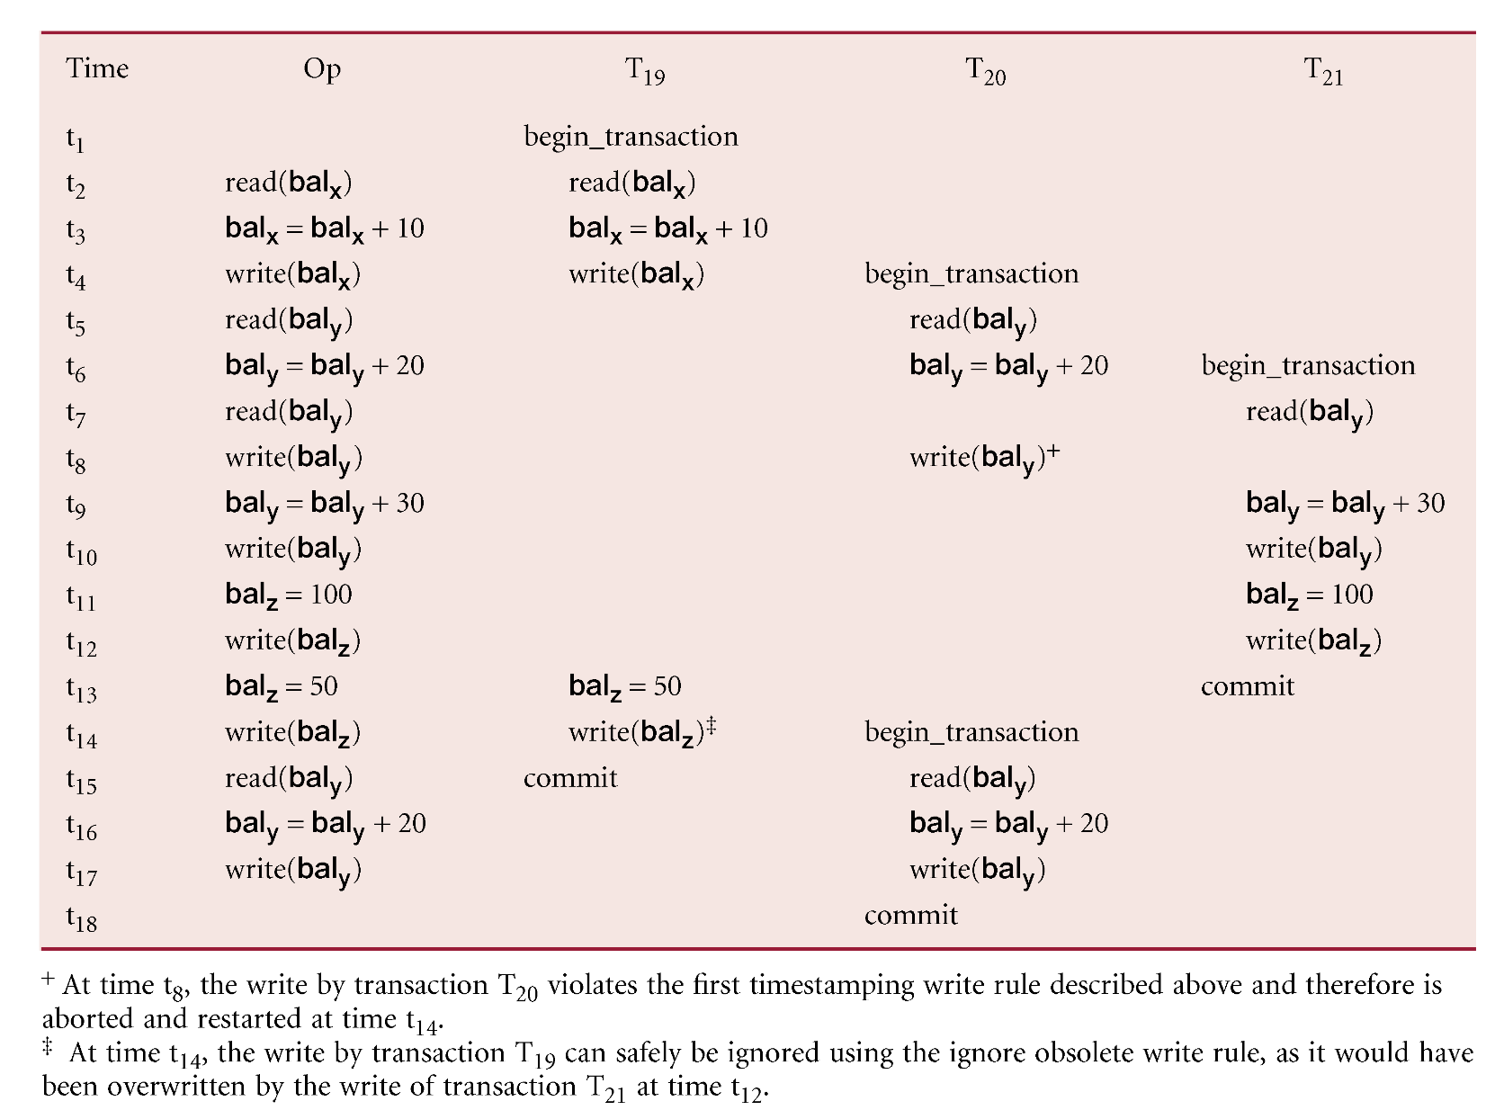
Example – Basic Timestamp Ordering

Slide 55
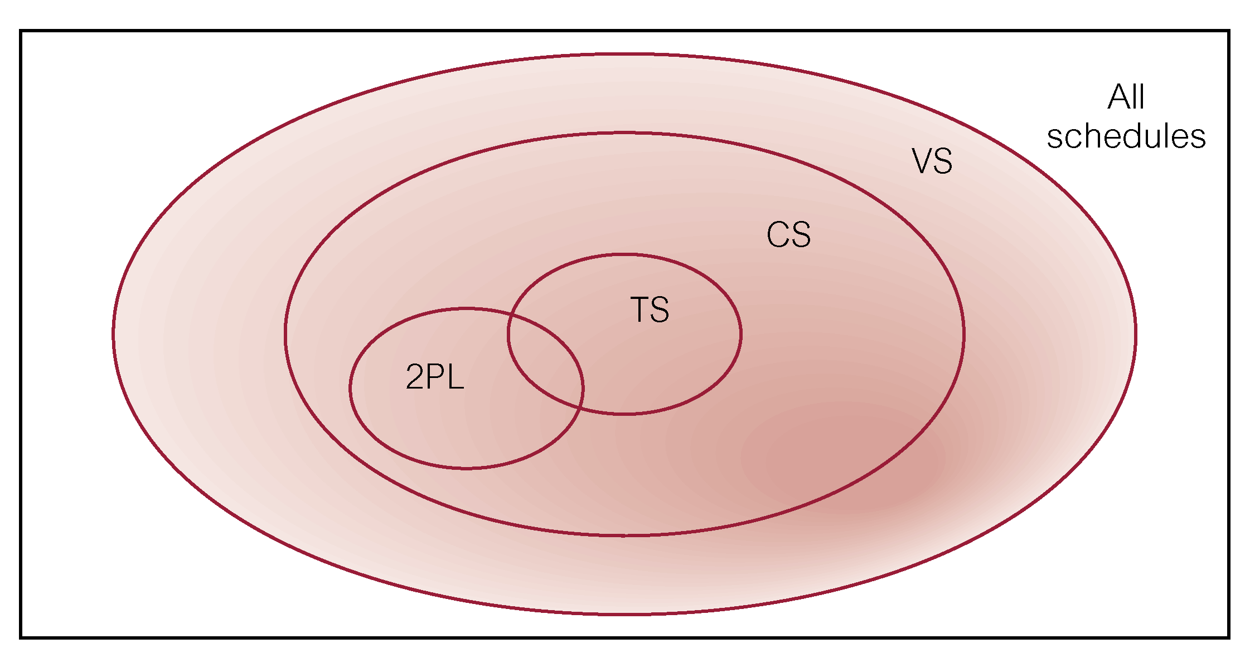
Comparison of Methods

Slide 56
Multiversion Timestamp Ordering
Versioning of data can be used to increase concurrency.
Basic timestamp ordering protocol assumes only one version of data item exists, and so only one transaction can access data item at a time.
Can allow multiple transactions to read and write different versions of same data item, and ensure each transaction sees consistent set of versions for all data items it accesses.
In multiversion concurrency control, each write operation creates new version of data item while retaining old version.
When transaction attempts to read data item, system selects the correct version of the data item according to the timestamp of the requesting transaction.
Versions can be deleted once they are no longer required.

Slide 57
Optimistic Techniques
Based on assumption that conflict is rare and more efficient to let transactions proceed without delays to ensure serializability.
At commit, check is made to determine whether conflict has occurred.
If there is a conflict, transaction must be rolled back and restarted.
Potentially allows greater concurrency than traditional protocols.

Slide 58
Optimistic Techniques
Read
Validation
Write

Slide 59
Optimistic Techniques - Read Phase
Extends from start until immediately before commit.
Transaction reads values from database and stores them in local variables. Updates are applied to a local copy of the data.

Slide 60
Optimistic Techniques - Validation Phase
Follows the read phase.
For read-only transaction, checks that data read are still current values. If no interference, transaction is committed, else aborted and restarted.
For update transaction, checks transaction leaves database in a consistent state, with serializability maintained.

Slide 61
Optimistic Techniques - Write Phase
Follows successful validation phase for update transactions.
Updates made to local copy are applied to the database.

Slide 62
Granularity of Data Items
Size of data items chosen as unit of protection by concurrency control protocol.
Ranging from coarse to fine:
The entire database.
A file.
A page (or area or database spaced).
A record.
A field value of a record.
Tradeoff:
coarser, the lower the degree of concurrency;
finer, more locking information that is needed to be stored.
Best item size depends on the types of transactions.

Slide 63
Hierarchy of Granularity
Could represent granularity of locks in a hierarchical structure.
Root node represents entire database, level 1s represent files, etc.
When node is locked, all its descendants are also locked.
DBMS should check hierarchical path before granting lock.

Slide 64
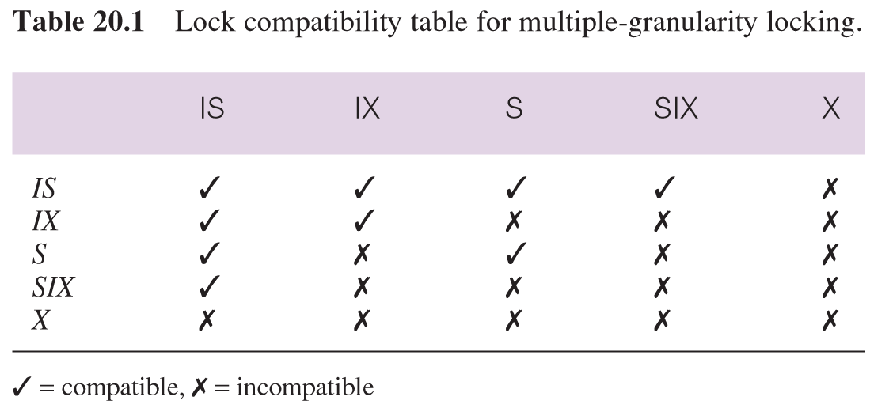
Hierarchy of Granularity
Intention lock could be used to lock all ancestors of a locked node.
Intention locks can be read or write. Applied top-down, released bottom-up.

Slide 65
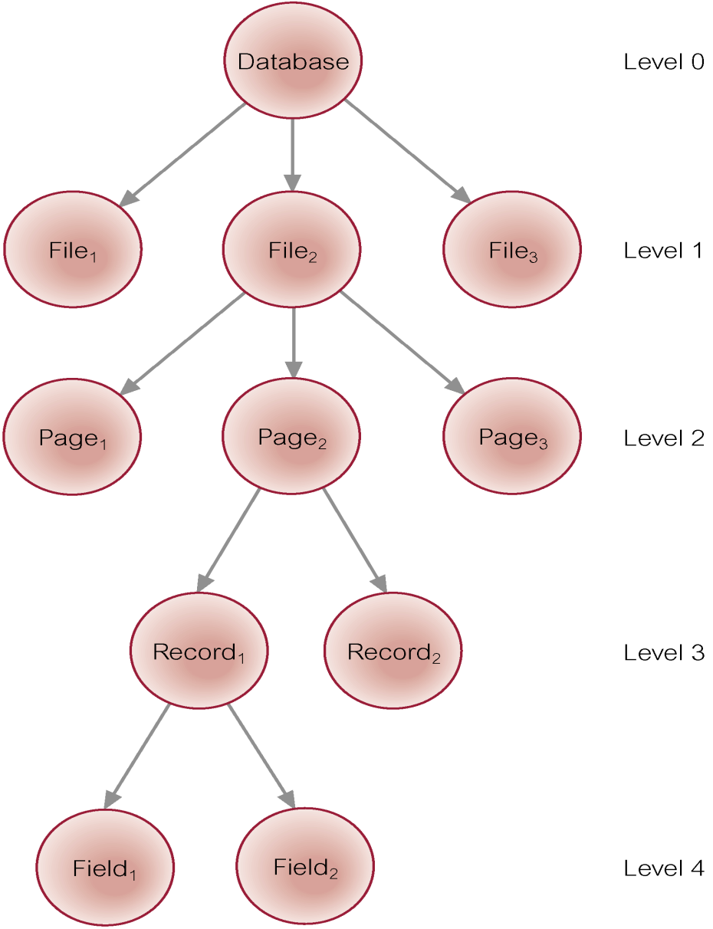
Levels of Locking

Slide 66
Database Recovery
Process of restoring database to a correct state in the event of a failure.
Need for Recovery Control
Two types of storage: volatile (main memory) and nonvolatile.
Volatile storage does not survive system crashes.
Stable storage represents information that has been replicated in several nonvolatile storage media with independent failure modes.

Slide 67
Types of Failures
System crashes, resulting in loss of main memory.
Media failures, resulting in loss of parts of secondary storage.
Application software errors.
Natural physical disasters.
Carelessness or unintentional destruction of data or facilities.
Sabotage.

Slide 68
Transactions and Recovery
Transactions represent basic unit of recovery.
Recovery manager responsible for atomicity and durability.
If failure occurs between commit and database buffers being flushed to secondary storage then, to ensure durability, recovery manager has to redo (rollforward) transaction’s updates.
If transaction had not committed at failure time, recovery manager has to undo (rollback) any effects of that transaction for atomicity.
Partial undo - only one transaction has to be undone.
Global undo - all transactions have to be undone.

Slide 69
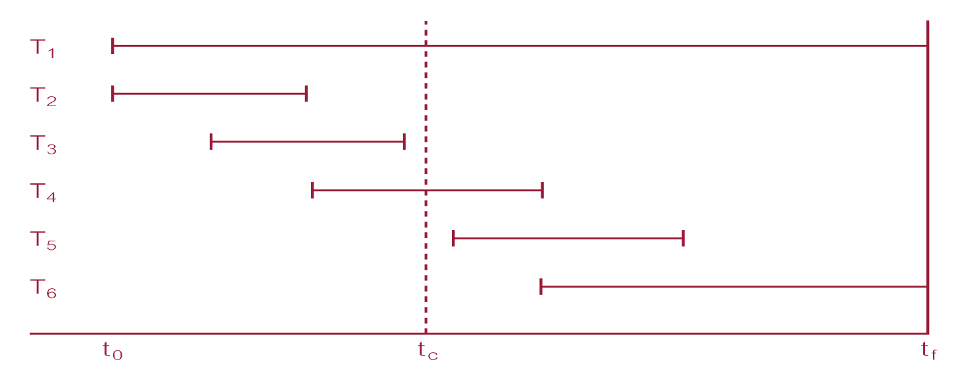
Example
DBMS starts at time t₀, but fails at time t_{f}. Assume data for transactions T₂ and T₃ have been written to secondary storage.
T₁ and T₆ have to be undone. In absence of any other information, recovery manager has to redo T₂, T₃, T₄, and T₅.

Slide 70
Recovery Facilities
DBMS should provide following facilities to assist with recovery:
Backup mechanism, which makes periodic backup copies of database.
Logging facilities, which keep track of current state of transactions and database changes.
Checkpoint facility, which enables updates to database in progress to be made permanent.
Recovery manager, which allows DBMS to restore database to consistent state following a failure.

Slide 71

Log File
Contains information about all updates to database:
Transaction records.
Checkpoint records.
Often used for other purposes (for example, auditing).
www.flaticon.com

Slide 72
Log File
Transaction records contain:
Transaction identifier.
Type of log record, (transaction start, insert, update, delete, abort, commit).
Identifier of data item affected by database action (insert, delete, and update operations).
Before-image of data item.
After-image of data item.
Log management information.
Log file may be duplexed or triplexed.
Log file sometimes split into two separate random-access files.
Potential bottleneck; critical in determining overall performance.

Slide 73
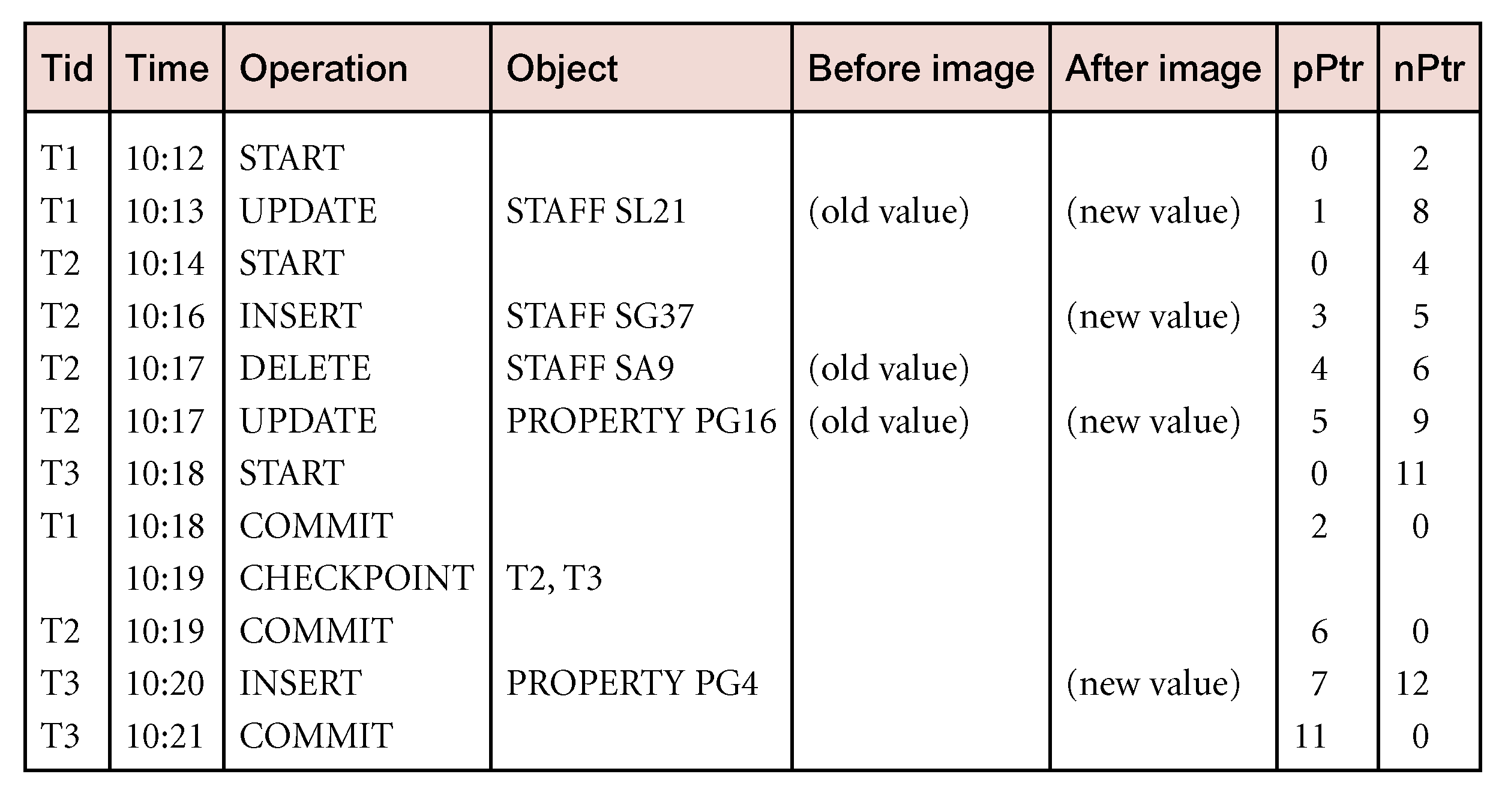
Sample Log File

Slide 74
Checkpointing
Checkpoint
Point of synchronization between database and log file. All buffers are force-written to secondary storage.
Checkpoint record is created containing identifiers of all active transactions.
When failure occurs, redo all transactions that committed since the checkpoint and undo all transactions active at time of crash.
In previous example, with checkpoint at time t_{c}, changes made by T₂ and T₃ have been written to secondary storage.
Thus:
only redo T₄ and T₅,
undo transactions T₁ and T6.

Slide 75
Recovery Techniques
If database has been damaged:
Need to restore last backup copy of database and reapply updates of committed transactions using log file.
If database is only inconsistent:
Need to undo changes that caused inconsistency. May also need to redo some transactions to ensure updates reach secondary storage.
Do not need backup, but can restore database using before- and after-images in the log file.

Slide 76
Main Recovery Techniques
Deferred Update
Immediate Update
Shadow Paging

Slide 77
1. Deferred Update
Updates are not written to the database until after a transaction has reached its commit point.
If transaction fails before commit, it will not have modified database and so no undoing of changes required.
May be necessary to redo updates of committed transactions as their effect may not have reached database.

Slide 78
2. Immediate Update
Updates are applied to database as they occur.
Need to redo updates of committed transactions following a failure.
May need to undo effects of transactions that had not committed at time of failure.
Essential that log records are written before write to database. Write-ahead log protocol.
If no “transaction commit” record in log, then that transaction was active at failure and must be undone.
Undo operations are performed in reverse order in which they were written to log.

Slide 79
3. Shadow Paging
Maintain two page tables during life of a transaction: current page and shadow page table.
When transaction starts, two pages are the same.
Shadow page table is never changed thereafter and is used to restore database in event of failure.
During transaction, current page table records all updates to database.
When transaction completes, current page table becomes shadow page table.

Slide 80
Advanced Transaction Models
Protocols considered so far are suitable for types of transactions that arise in traditional business applications, characterized by:
Data has many types, each with small number of instances.
Designs may be very large.
Design is not static but evolves through time.
Updates are far-reaching.
Cooperative engineering.

Slide 81
Advanced Transaction Models
May result in transactions of long duration, giving rise to following problems:
More susceptible to failure - need to minimize amount of work lost.
May access large number of data items - concurrency limited if data inaccessible for long periods.
Deadlock more likely.
Cooperation through use of shared data items restricted by traditional concurrency protocols.
Look at five advanced transaction models:
Nested Transaction Model
Sagas
Multi-level Transaction Model
Dynamic Restructuring
Workflow Models

Slide 82
Nested Transaction Model
Transaction viewed as hierarchy of subtransactions.
Top-level transaction can have number of child transactions.
Each child can also have nested transactions.
In Moss’s proposal, only leaf-level subtransactions allowed to perform database operations.
Transactions have to commit from bottom upwards.
However, transaction abort at one level does not have to affect transaction in progress at higher level.

Slide 83
Nested Transaction Model
Parent allowed to perform its own recovery:
Retry subtransaction.
Ignore failure, in which case subtransaction non-vital.
Run contingency subtransaction.
Abort.
Updates of committed subtransactions at intermediate levels are visible only within scope of their immediate parents.
Further, commit of subtransaction is conditionally subject to commit or abort of its superiors.
Using this model, top-level transactions conform to traditional ACID properties of flat transaction.

Slide 84
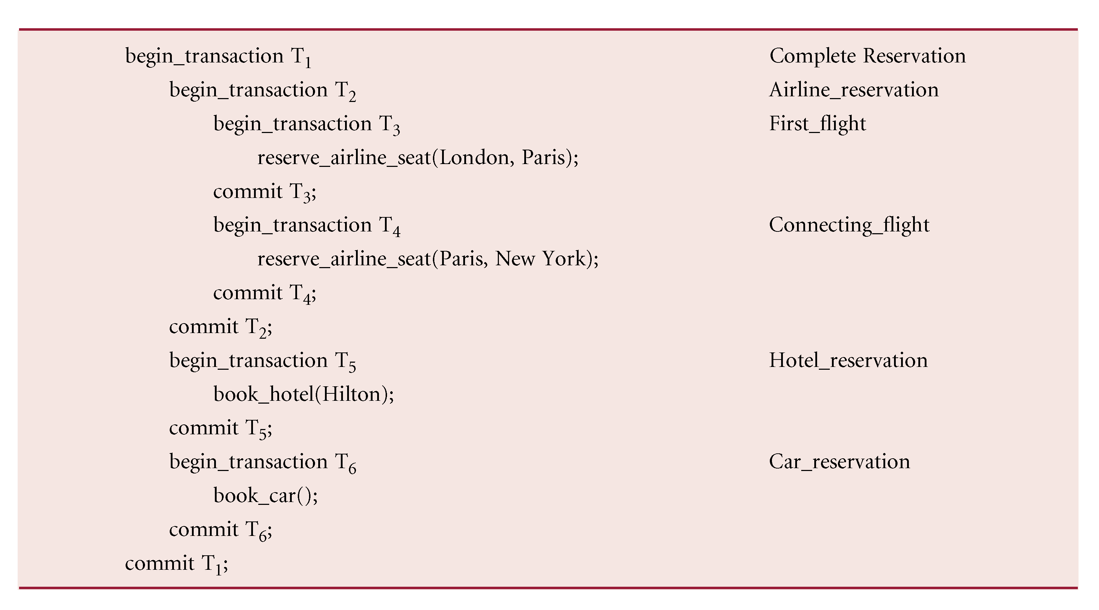
Example of Nested Transactions

Slide 85
Nested Transaction Model - Advantages
Modularity - transaction can be decomposed into number of subtransactions for purposes of concurrency and recovery.
Finer level of granularity for concurrency control and recovery.
Intra-transaction parallelism.
Intra-transaction recovery control.

Slide 86
Emulating Nested Transactions using Savepoints
An identifiable point in flat transaction representing some partially consistent state.
Can be used as restart point for transaction if subsequent problem detected.
During execution of transaction, user can establish savepoint, which user can use to roll transaction back to.
Unlike nested transactions, savepoints do not support any form of intra-transaction parallelism.

Slide 87
Sagas
“A sequence of (flat) transactions that can be interleaved with other transactions”.
DBMS guarantees that either all transactions in saga are successfully completed or compensating transactions are run to undo partial execution.
Saga has only one level of nesting.
For every subtransaction defined, there is corresponding compensating transaction that will semantically undo subtransaction’s effect.

Slide 88
Sagas
Relax property of isolation by allowing saga to reveal its partial results to other concurrently executing transactions before it completes.
Useful when subtransactions are relatively independent and compensating transactions can be produced.
May be difficult sometimes to define compensating transaction in advance, and DBMS may need to interact with user to determine compensation.

Slide 89
Multi-level Transaction Model
Closed nested transaction - atomicity enforced at the top-level.
Open nested transactions - allow partial results of subtransactions to be seen outside transaction.
Saga model is example of open nested transaction.
So is multi-level transaction model where tree of subtransactions is balanced.
Nodes at same depth of tree correspond to operations of same level of abstraction in DBMS.

Slide 90
Multi-level Transaction Model
Edges represent implementation of an operation by sequence of operations at next lower level.
Traditional flat transaction ensures no conflicts at lowest level (L0).
In multi-level model two operations at level Li may not conflict even though their implementations at next lower level Li-1 do.

Slide 91
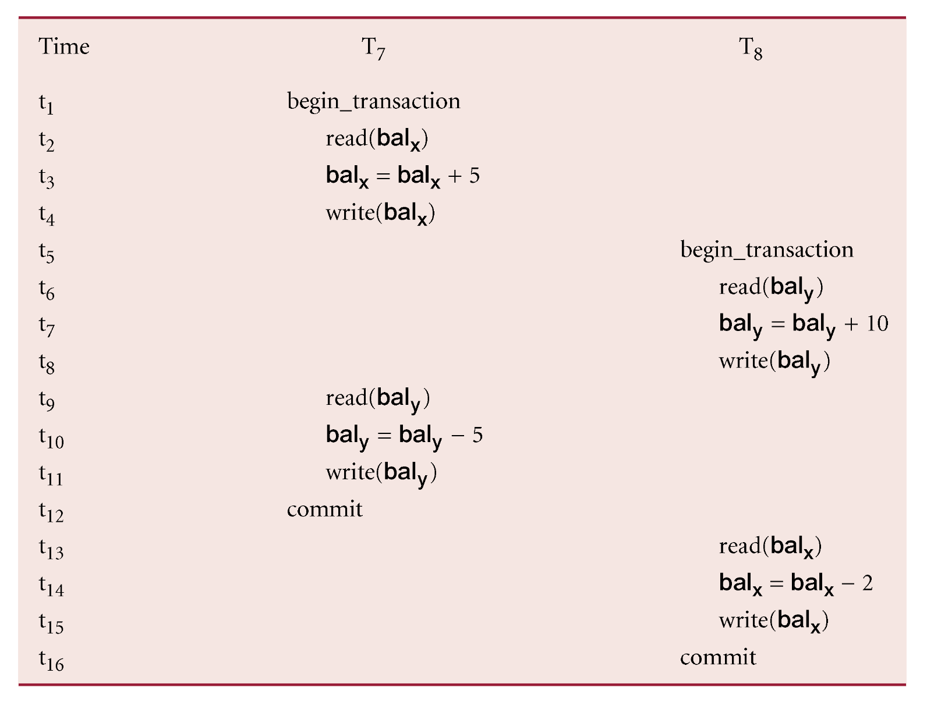
Example - Multi-level Transaction Model

Slide 92
Example - Multi-level Transaction Model
T₇: T₇₁, which increases bal_{x} by 5
T₇₂, which subtracts 5 from bal_{y}
T₈: T₈₁, which increases bal_{y} by 10
T₈₂, which subtracts 2 from bal_{x}
As addition and subtraction commute, can execute these subtransactions in any order, and correct result will always be generated.

Slide 93
Dynamic Restructuring
To address constraints imposed by ACID properties of flat transactions, two new operations proposed: split_transaction and join_transaction.
split-transaction - splits transaction into two serializable transactions and divides its actions and resources (for example, locked data items) between new transactions.
Resulting transactions proceed independently.
Allows partial results of transaction to be shared, while still preserving its semantics.
Can be applied only when it is possible to generate two transactions that are serializable with each other and with all other concurrently executing transactions.

Slide 94
Dynamic Restructuring
Conditions that permit transaction to be split into A and B are:
AWriteSet ∩ BWriteSet ⊆ BWriteLast.
If both A and B write to same object, B’s write operations must follow A’s write operations.
AReadSet ∩ BWriteSet = ∅.
A cannot see any results from B.
BReadSet ∩ AWriteSet = ShareSet.
B may see results of A.
These guarantee that A is serialized before B.
However, if A aborts, B must also abort.
If both BWriteLast and ShareSet are empty, then A and B can be serialized in any order and both can be committed independently.

Slide 95

Dynamic Restructuring
join-transaction - performs reverse operation, merging ongoing work of two or more independent transactions, as though they had always been single transaction.
Main advantages of dynamic restructuring are:
Adaptive recovery.
Reducing isolation.
www.kpmg.com

Slide 96
Workflow Models
Has been argued that above models are still not powerful to model some business activities.
More complex models have been proposed that are combinations of open and nested transactions.
However, as they hardly conform to any of ACID properties, called workflow model used instead.
Workflow is activity involving coordinated execution of multiple tasks performed by different processing entities (people or software systems).
Two general problems involved in workflow systems:
specification of the workflow,
execution of the workflow.
Both problems complicated by fact that many organizations use multiple, independently managed systems to automate different parts of the process.

Slide 97

www.healthytravelblog.com

